Slide 1

Ear Training at Berklee
Allan Chase, Chair, Ear Training

Slide 2
Tendency-Tone Pairs and Patterns
Tonal and modal melodic resolution patterns
(in C for reference)

Slide 6
Principle
Tones that are not members of the tonic triad tend to resolve by step to the nearest note of the tonic triad.
Resolution to the tonic note and/or resolution down are stronger when two stepwise options are equal:
Re/2-Do/1 more than Re/2-Mi/3 in major
Fa/4-Me/b3 more than Fa/4-Sol/5 in minor
Tones of the tonic triad tend to return by leap or step to the tonic note.
Sol/5-Do/1; Mi/3-Do/1, Me/b3-Do/1

Slide 7
These tendencies are enculturated by exposure to the simplest, most direct melodies in Western music
Songs of childhood
Sing-along music

Slide 8
Recognition of tendency-tone patterns is an important factor in identifying the tonic and orientation to the key.
Knowledge of them is important for artistic choices:
control of indirect resolution, ambiguity, deception, bitonality, or atonality,
creating and recognizing normal, satisfying tonal and modal resolutions.

Slide 9
Exception
In the context of secondary dominant harmony (or some °7ths), chromatic notes' tendencies come from the secondary key, but they are named in the primary key.
the 3rd of V7/II, Di/#1, is "Ti/7 of II," a secondary leading tone

Slide 14
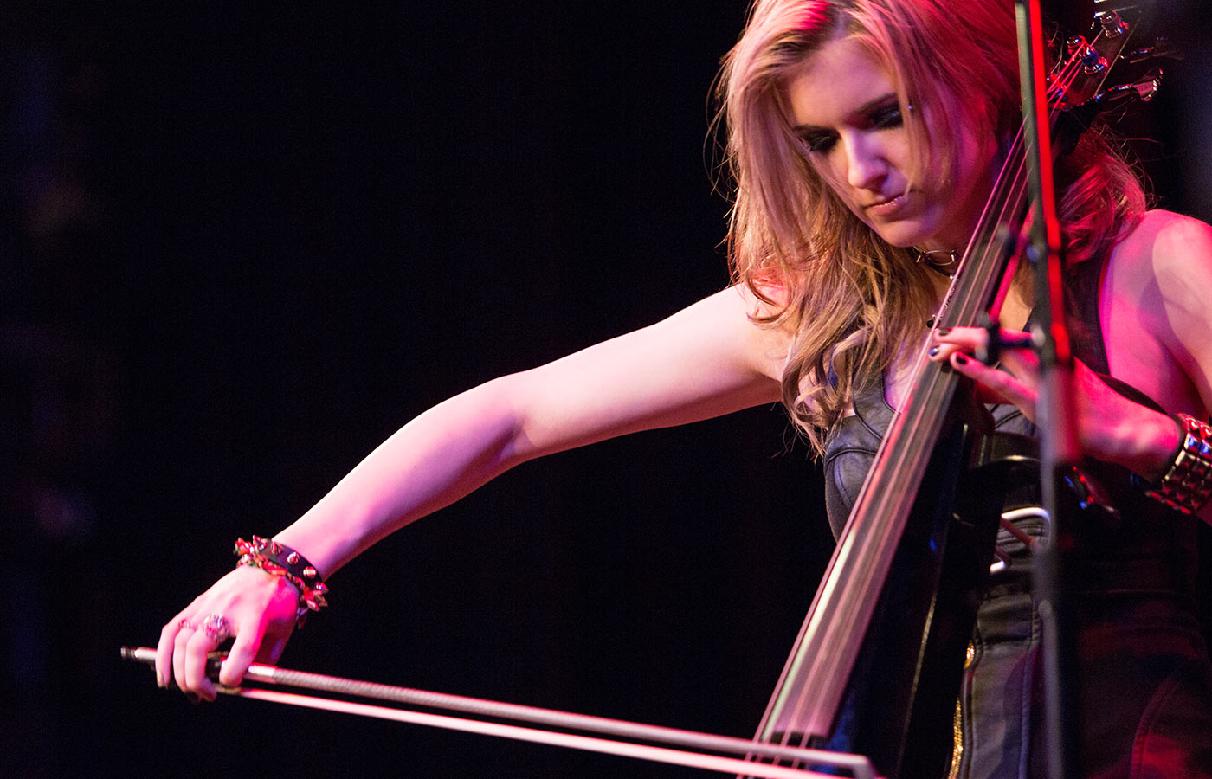
Questions?

Slide 15

Thank you

